Slide 1
My Geometry Interactive Notebook
Name
Class
Term 4 Semester 2

Slide 2
Contents
Formula Page
Page
Date
Description
2
3

Slide 3
Tasks
24
7
30
Essential Question
Questions
Notes
Summary

Slide 4
24
7
30
Date
Similar Triangles
EQ – How can I determine if two triangles are similar?

Slide 5
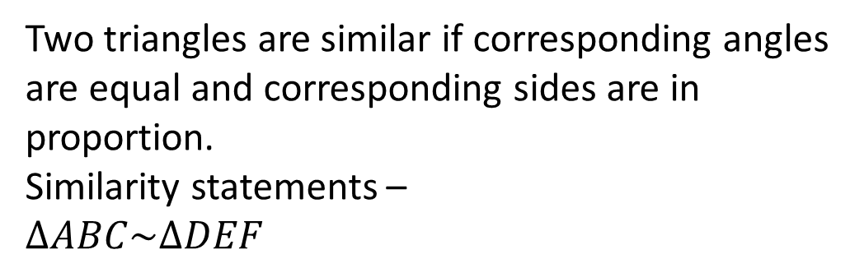
24
7
30
Date
Similar Triangles
EQ – How can I determine if two triangles are similar?
Two triangles are similar if corresponding angles are equal and corresponding sides are in proportion.
Similarity statements –
$$∆ABC\sim ∆DEF$$

Slide 6
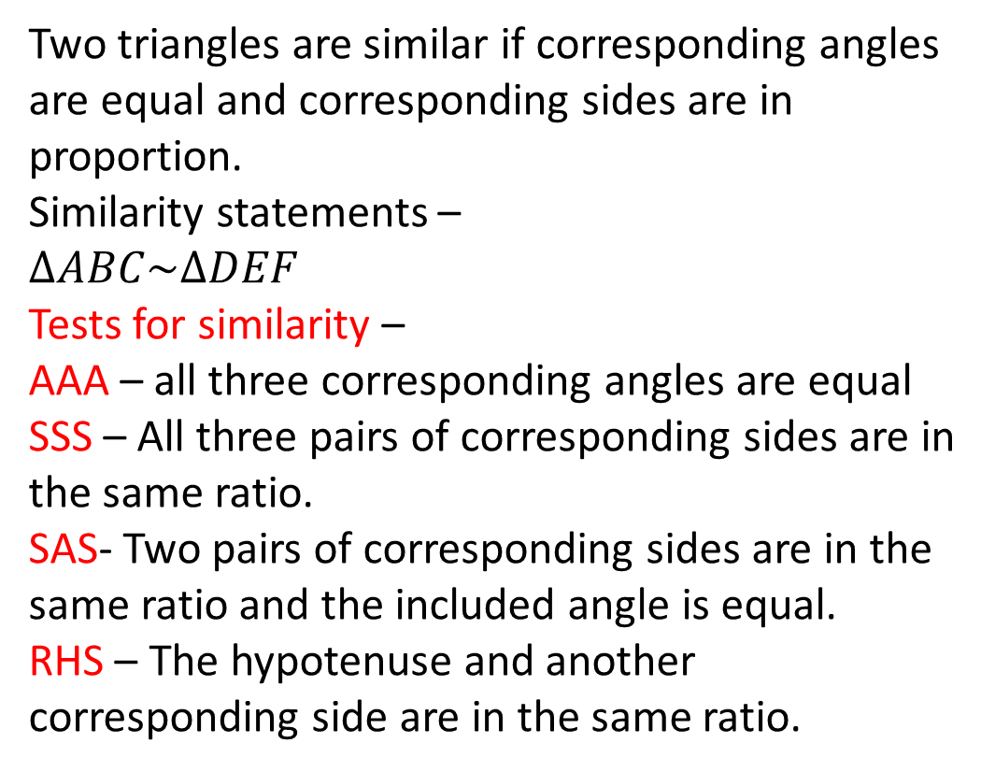
24
7
30
Date
Similar Triangles
EQ – How can I determine if two triangles are similar?
Two triangles are similar if corresponding angles are equal and corresponding sides are in proportion.
Similarity statements –
$$∆ABC\sim ∆DEF$$
Tests for similarity –
AAA – all three corresponding angles are equal
SSS – All three pairs of corresponding sides are in the same ratio.
SAS- Two pairs of corresponding sides are in the same ratio and the included angle is equal.
RHS – The hypotenuse and another corresponding side are in the same ratio.

Slide 7
Notes Review
24, 7 ,30
Date
Title
Essential question
Notes complete
Notes complete with colour and diagrams
Questions completed
Contents page filed in
Formula page filled in

Slide 8
Homework
Review your notes and write a summary answering the essential question.

